Slide 1

Financial News headlines Sentiment Classification
NLP Final Project
Fall 2025
DATS 6312.11- NLP
Abirham Getie
Julio Montoya

Slide 2
Scope of the Project
Financial markets react strongly to the tone of news headlines.
Positive news boosts investor confidence, while negative news often triggers sell-offs
Short-term price movements are affected by sentiment and investor psychology
Huge volume of daily financial news makes manual sentiment evaluation impossible.
This project uses NLP to automatically classify headlines as positive, negative, or neutral
Goal: Explore how news sentiment influences market behavior and supports better investment decisions
Notes:
Kristin
Glioma - glial cell cancer
Meningioma - Spinal cord cancer
Pituitary - Pituitary gland cancer

Slide 3
Dataset
Source: Massive Stock News Analysis Database (Kaggle)
Samples: 4 million of financial news headlines from 2009 to 2020. For running purposes we use only 10,000 rows for our project.
• Headline text • Publisher • Publication date • Stock name
Notes:
Kristin
Glioma - glial cell cancer
Meningioma - Spinal cord cancer
Pituitary - Pituitary gland cancer

Slide 4
Preprocessing
Cleaning Data (headline, publisher, date, stock name)
• Lowercasing
• URLs symbols & numbers
• Multiple spaces
• SpaCy lemmatization
• Stopwords
FinBERT Tokenization
• Truncate to 128 tokens
• Convert to tensors
FinBERT Sentiment
• negative / neutral / positive
• Softmax confidence score
Raw dataset (1.8 M)
Cleaned labelled
dataset
Notes:
Kristin
Glioma - glial cell cancer
Meningioma - Spinal cord cancer
Pituitary - Pituitary gland cancer

Slide 5
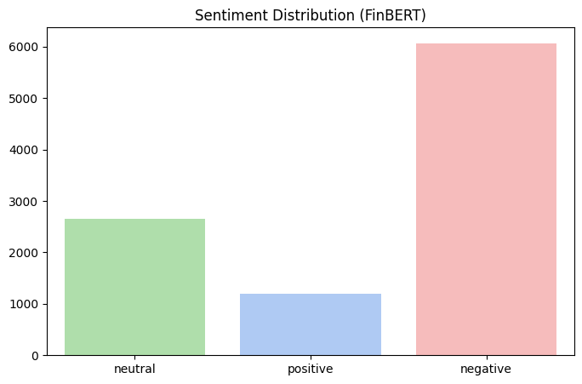
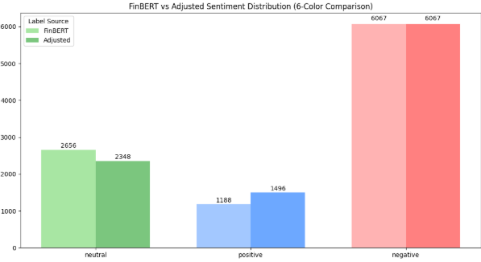
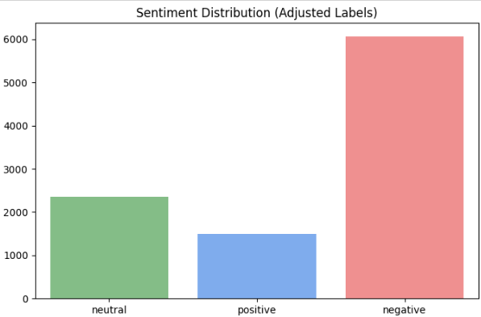
EDAs Analysis
Notes:
Kristin
Glioma - glial cell cancer
Meningioma - Spinal cord cancer
Pituitary - Pituitary gland cancer

Slide 6
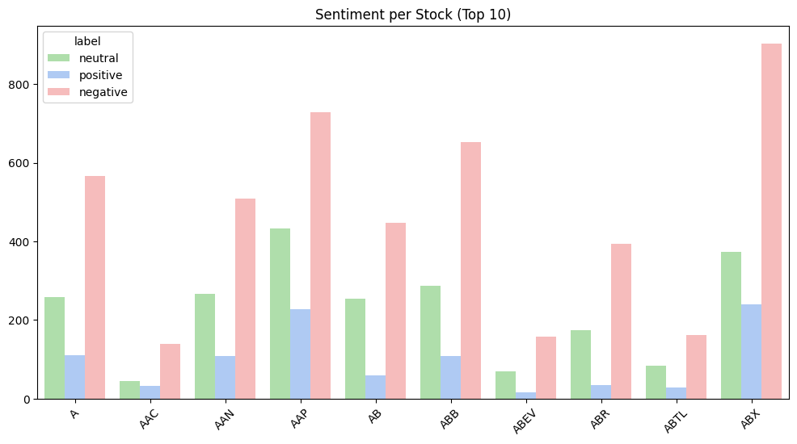
EDAs Analysis
Notes:
Kristin
Glioma - glial cell cancer
Meningioma - Spinal cord cancer
Pituitary - Pituitary gland cancer

Slide 7
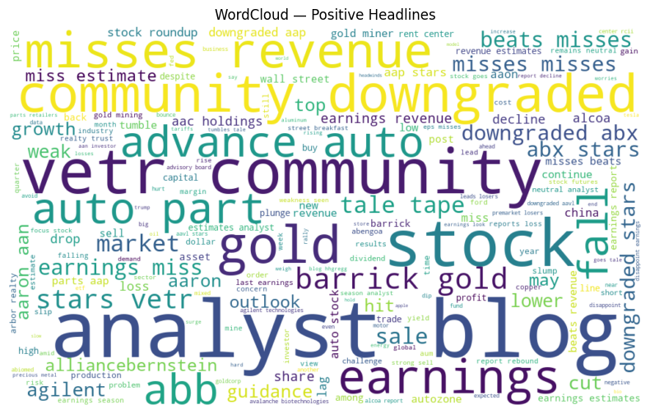
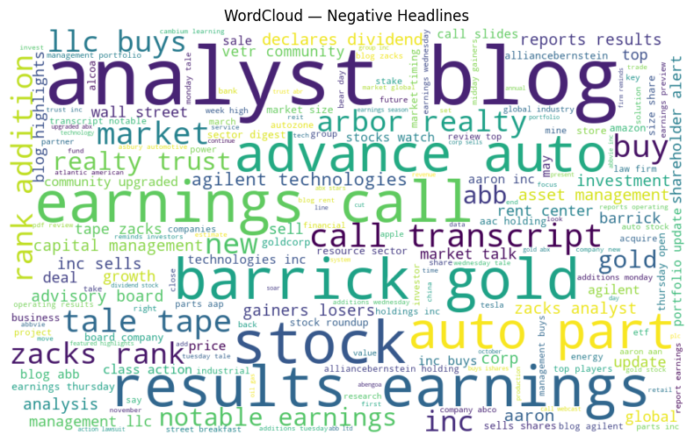
EDAs Analysis
Positive
Earnings, revenue, growth, hit, beats, stock(financial words)
auto, gold, barrick, ABB (Industries)
Negative
Earnings, results, recall, slides, transcript (financial words)
auto, gold, barrick (Industries)
Notes:
Kristin
Glioma - glial cell cancer
Meningioma - Spinal cord cancer
Pituitary - Pituitary gland cancer

Slide 8
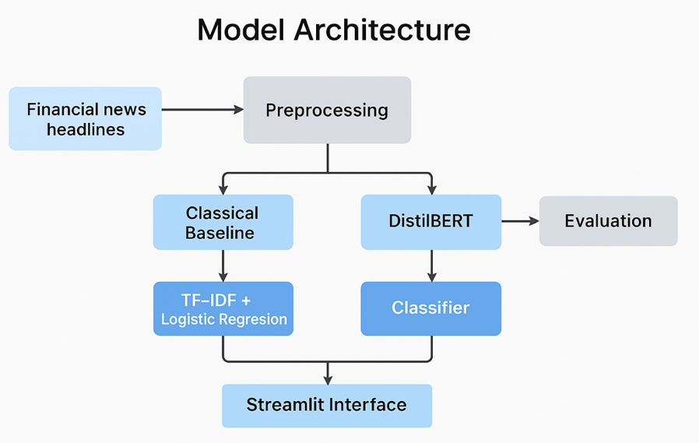
Model Architecture

Slide 9
Traditional Models
Results
Used Logistic Regression with TF-IDF as the baseline model.
Performed well on negative and neutral classes.
Evaluated using Accuracy and Macro F1-score to handle class imbalance.
Results: Achieved 80% accuracy and a 0.746 Macro-F1 score.
Class | Precision | Recall | F1-score | Support
Negative | 0.90 | 0.84 | 0.87 | 910
Neutral | 0.75 | 0.77 | 0.76 | 399
Positive | 0.52 | 0.67 | 0.58 | 178
Accuracy |  |  | 0.80 | 1,487
Macro Avg | 0.72 | 0.76 | 0.74 | 1,487
Weighted Avg | 0.81 | 0.80 | 0.81 | 1,487

Slide 10
DistilBERT Transformer Model
Results
We Fine-tuned the pretrained model on our dataset using AdamW, 6 epochs, and learning rate 2e-5.
Learns the context of the headlines better than classical models.
Results: Achieved 0.88 accuracy and 0.84 macro-F1, clearly outperforming TF-IDF
Epoch | Train Loss | Val Loss | Val Acc | Val F1
1 | 0.2198 | 0.4053 | 0.8574 | 0.8193
2 | 0.1686 | 0.3901 | 0.8668 | 0.8195
3 | 0.1106 | 0.4331 | 0.8749 | 0.8333
4 | 0.0762 | 0.4627 | 0.8716 | 0.8307
5 | 0.0522 | 0.4787 | 0.8763 | 0.8345
6 | 0.0396 | 0.4855 | 0.8796 | 0.8388

Slide 11
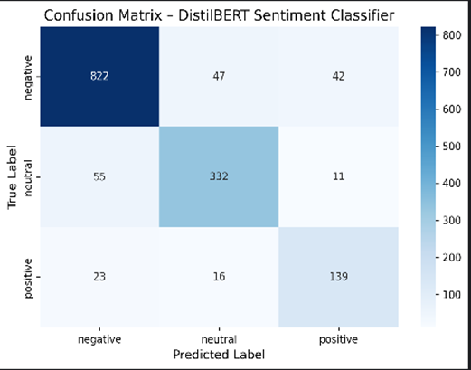
Confusion Matrix
Highlights:
Strong performance on negative and neutral classes
Positive is the most difficult class
Some neutral headlines predicted as negative
Some negative headlines predicted as neutral

Slide 12
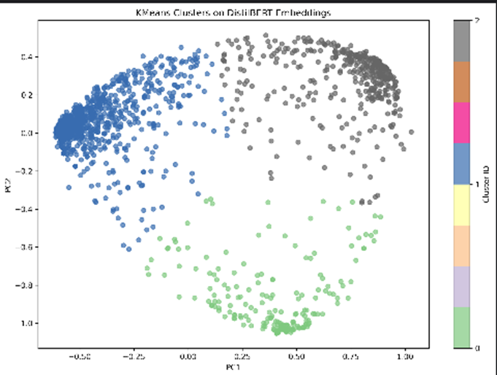
Embedding Analysis
We applied PCA and K-Means to reduce the CLS embeddings to 2D and explore how the model organizes financial headlines in semantic space.
Results:
The Transformer forms meaningful clusters, showing that DistilBERT learns underlying structure in the headlines even when sentiment is subtle or overlapping.

Slide 13
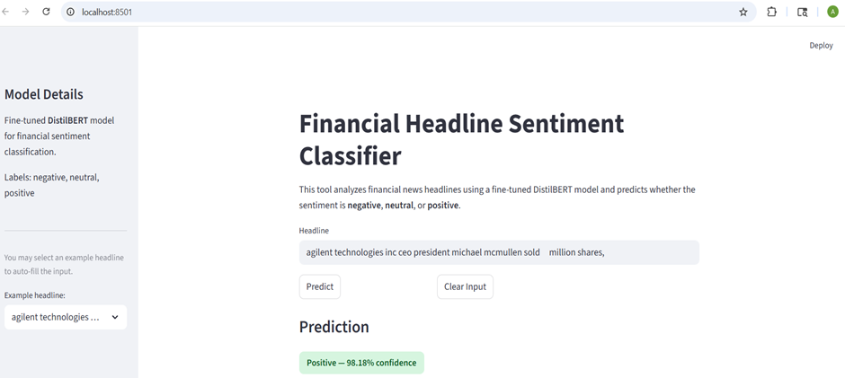
Streamlit dashboard
Built a simple Stream-lit interface to experiment with the model in real time.
Users can play and enter any financial headline and receive a real-time sentiment prediction with class probabilities.

Slide 14
Takeaways
Considering DistilBERT needs labeled dataset, we have used FinBERT to transform and label our dataset in preprocessing.
DistilBERT significantly outperformed the TF-IDF model, especially on context-dependent headlines
We can say that Classical models captured surface-level patterns, while the Transformer learned deeper financial semantics.
Positive sentiment remains the hardest class due to class imbalance
The model can be extended by using other transformer models, more data, or interpretability tools.

Slide 15
Thank you

